Slide 1
PHASES
OF
COMPILER

Slide 2
COMPILER
Compiler is a program that reads a program written in one language (source language) and translates it into an equivalent program in another language (the target language).
As an important part of this translation process, the compiler reports to its user the presence of errors in the source program.
Source Program
Compiler
Target Program
Error Messages

Slide 3
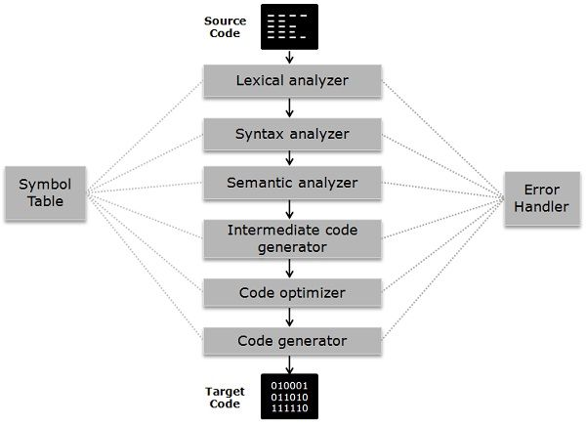
Phases of a Compiler
Conceptually, a compiler operates in phases, each of which transforms the source program from one representation to another.

Slide 4
Lexical Analysis
The first phase of a compiler is called lexical analysis or scanning. It is also called as linear analysis.
The lexical analyzer reads the stream of characters making up the source program and groups the characters into meaningful sequences called lexemes.
For each lexeme, the lexical analyzer produces as output a token of the form
(token-name, attribute-value)
that it passes on to the subsequent phase, syntax analysis.
In the token, the first component token-name is an abstract symbol that is used during syntax analysis, and the second component attribute-value points to an entry in the symbol table for this token.
Information from the symbol-table entry is needed for semantic analysis and code generation.

Slide 5
Lexical Analysis
For example, suppose a source program contains the assignment statement
position = initial + rate * 60
position is a lexeme that would be mapped into a token (id, 1), where id is an abstract symbol standing for identifier and 1 points to the symbol table entry for position. The symbol-table entry for an identifier holds information about the identifier, such as its name and type.
The assignment symbol = is a lexeme that is mapped into the token (=). Since this token needs no attribute-value.
initial is a lexeme that is mapped into the token (id, 2), where 2 points to the symbol-table entry for initial .
+ is a lexeme that is mapped into the token (+).
rate is a lexeme that is mapped into the token (id, 3), where 3 points to the symbol-table entry for rate .
* is a lexeme that is mapped into the token (*).
60 is a lexeme that is mapped into the token (number type,value). ➔ (Integer, 60)

Slide 6
Lexical Analysis
position = initial + rate * 60
(id,1) = (id,2) + (id,3) * (number,60)
For understanding easier and for our convenience, We can write this as
id1 = id2 + id3 * 60

Slide 7
Syntax Analysis
The second phase of the compiler is syntax analysis or parsing.
The parser uses the first components of the tokens produced by the lexical analyzer to create a tree-like intermediate representation that depicts the grammatical structure of the token stream.
A typical representation is a syntax tree in which each interior node represents an operation and the children of the node represent the arguments of the operation.

Slide 8
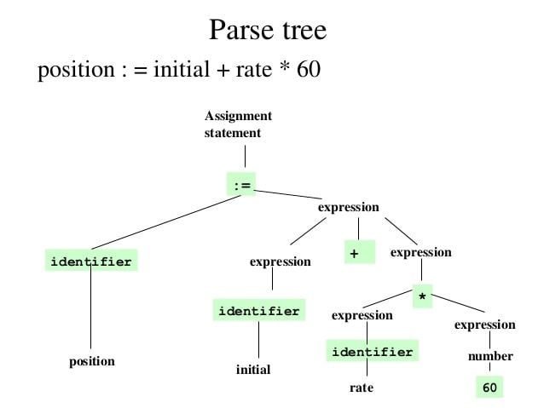
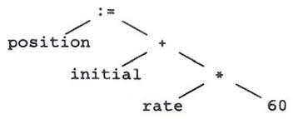
Syntax Tree

Slide 9
Semantic Analysis
The semantic analyzer uses the syntax tree and the information in the symbol table to check the source program for semantic consistency with the language definition.
It also gathers type information and saves it in either the syntax tree or the symbol table, for subsequent use during intermediate-code generation.
An important part of semantic analysis is type checking, where the compiler checks that each operator has matching operands.
For example, many programming language definitions require an array index to be an integer; the compiler must report an error if a floating-point number is used to index an array.

Slide 10
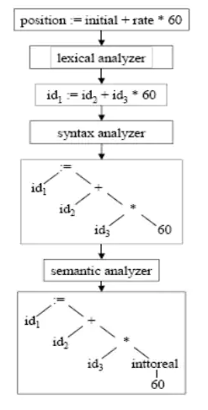
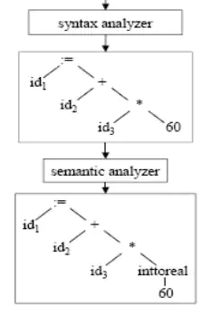
Semantic Analysis

Slide 11
Semantic Analysis
The language specification may permit some type conversions called coercions. (Conversion from one type to another is said to be implicit if it is to be done automatically by the compiler. Implicit type conversions, also called Coercions (no information is lost in principle).
int b;
float a;
a = b;
Conversion is said to be explicit if the programmer must write something to cause the conversion.
int b;
float a;
a = (int) b;

Slide 12
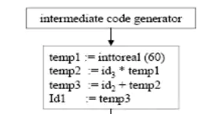
Intermediate Code Generation
After syntax and semantic analysis of the source program, many compilers generate an explicit low-level or machine-like intermediate representation.
In the process of translating a source program into target code, a compiler may construct one or more intermediate representations, which can have a variety of forms.
This intermediate representation should have two important properties: it should be easy to produce and it should be easy to translate into the target machine

Slide 13
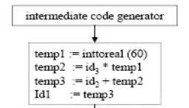
Intermediate Code Generation
One of the mostly used intermediate form called three-address code, which consists of a sequence of assembly-like instructions with three operands per instruction.
Three-address instruction has several important properties:
First, each three-address assignment instruction has at most one operator on the right side.
Second, the compiler must generate a temporary name to hold the value computed by a three-address instruction.
Third, some three-address instructions have fewer than three operands.

Slide 14
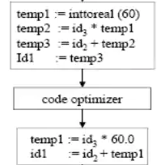
Code Optimization
The machine-independent code-optimization phase attempts to improve the intermediate code so that better target code will result. Usually better means faster, but other objectives may be desired, such as shorter code, or target code that consumes less power.
There is a great variation in the amount of code optimization different compilers perform.
Optimizing compilers spent a significant amount of time is spent on this phase. There are simple optimizations that significantly improve the running time of the target program without slowing down compilation too much.

Slide 15
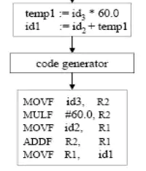
Code Generation
Final phase of the compiler is generation of target code, consisting normally of relocatable machine code or assembly code.
Memory locations are selected for each of the variables used by the program.
Then, the intermediate instructions are translated into sequences of machine instructions that perform the same task.
A crucial aspect of code generation is the judicious assignment of registers to hold variables.

Slide 16
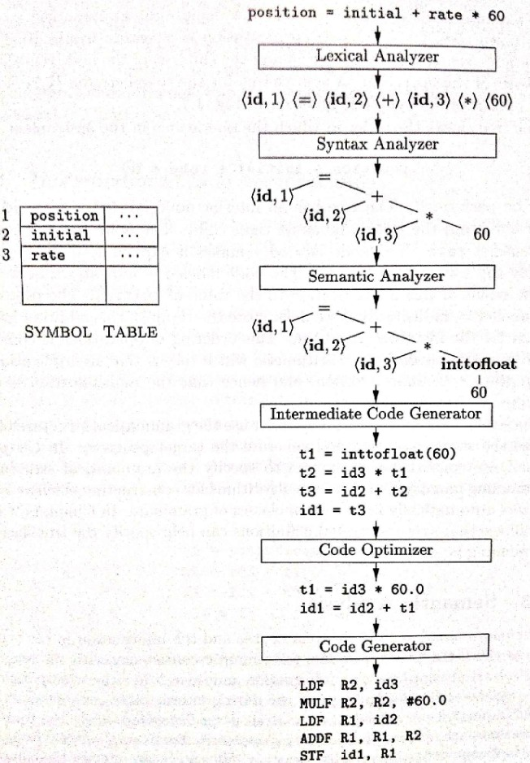

Slide 17
Symbol Table Management
An essential function of a compiler is to record the variable names used in the source program and collect information about various attributes of each name. These attributes may provide information about the storage allocated for a name, its type, its scope (where in the program its value may be used), and in the case of procedure names, such things as the number and types of its arguments, the method of passing each argument (for example, by value or by reference), and the type returned.
The symbol table is a data structure containing a record for each variable name, with fields for the attributes of the name.
The data structure should be designed to allow the compiler to find the record for each name quickly and to store or retrieve data from that record quickly.

Slide 18
Symbol Table Management
Symbol Table for Identifiers (Variables)
Name of the Symbol | Location | Type | Scope | Value | Size | …
Symbol Table for Identifiers (Functions)
Name of the Symbol | No. of Arguments | Type of Arguments | Scope | Return type | …

Slide 19
Error Detection and Reporting
Each phase can encounter Errors. However, after detecting an error, a phase must somehow deal with that error, so that compilation can proceed, allowing further errors in the source program to be detected.
The syntax and semantic analysis phases usually handle a large fraction of the errors detectable by the compiler.
Some Errors in Phases of Compiler
Lexical analyzer: Wrongly spelled tokens
Syntax analyzer: Missing parenthesis
Semantic analyzer: Mismatched operands for an operator
Intermediate code generator: When the memory is full when generating temporary variables
Code Optimizer: When the statement is not reachable
Code Generator: When the memory is full or proper registers are not allocated

